Slide 1
MS Excel
Lecturer: Ngo Huy Bien
Software Engineering Department
Faculty of Information Technology
VNUHCM - University of Science
Ho Chi Minh City, Vietnam
nhbien@fit.hcmus.edu.vn

Slide 2

Objectives

Slide 3

Contents

Slide 4

References

Slide 5
Cell reference in Excel
A cell reference or cell address is a combination of a column letter and a row number that identifies a cell on a worksheet.
For example, A1 refers to the cell at the intersection of column A and row 1.
A relative reference is the one without the $ sign in the row and column coordinates, like A1. By default, all cell addresses in Excel are relative.
An absolute reference is the one with the dollar sign ($) in the row or column coordinates, like $A$1 or $C$12.
An absolute cell reference remains unchanged when filling other cells with the same formula.
Absolute addresses are especially useful when you want to perform multiple calculations with a value in a specific cell or when you need to copy a formula to other cells without changing references.

Slide 6
COUNTIF function
Inputs: - range: Required.
- criteria: Required. Selects the row in array from which to return a value.
Output: - Returns the count of the cells with text.
Examples:
- COUNTIF(A7:A32, "*"). The "*" symbol specifies anything other than numbers to be counted, including blank spaces and special characters.
- COUNTIF(A7:A32, "?*"). The "?*" criteria counts the cells which have at least one character.

Slide 7
INDEX function
Inputs: - array: Required. A range of cells or an array constant.
- row_num: Required. Selects the row in array from which to return a value.
- column_num: Optional. Selects the column in array from which to return a value.
Output: - Returns the value of an element in a table or an array, selected by the row and column number indexes.
Examples:
- INDEX(A2:C6, 2, 3) = The intersection of the second row and third column in the range A2:C6, which is the contents of cell C3.
- INDEX(L18:W18<>0,) = TRUE/FALSE
- INDEX($L$15:$W$15,1) = The contents of cell $L$15.

Slide 8
MATCH function
Inputs: - lookup_value: Required. The value that you want to match in lookup_array.
- lookup_array: Required. The range of cells being searched.
- match_type: Optional. The number -1 (smallest value), 0 (first value), or 1 (largest value, default).
Output: - Returns the position of the matched value within lookup_array, not the value itself.
Examples:
- MATCH(TRUE,INDEX(L18:W18<>0,),0) = 1

Slide 9
WORKDAY function
Inputs: - Start_date: Required. - Days: Required. The number of nonweekend and nonholiday days after Start_date. - Holidays: Optional. An optional list of one or more dates to exclude from the working calendar, such as state and federal holidays and floating holidays.
Output: - End_date = Start_date + number of working days before or after a date (the starting date) - Holidays.

Slide 10
SUBTOTAL function
Inputs:
- function_num: Required. Examples: 109 = SUM, 101 = AVERAGE.
- ref1: Required. The first named range or reference for which you want the subtotal. Range example: A2:A5. Column name example: [Hours Total].
Output:
- Returns a subtotal (e.g. SUM) in a list or database (e.g. ref1).

Slide 11
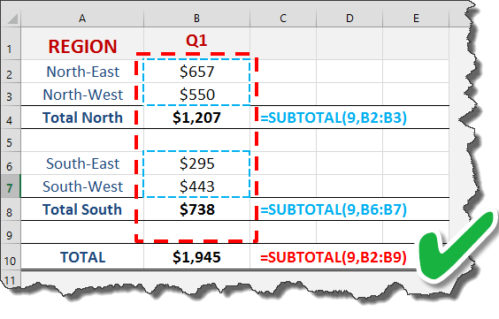
Why SUBTOTAL function?
You can use SUBTOTAL to ignore values in hidden rows.
You can use SUBTOTAL to dynamically summarize data
If there are subtotals in SUBTOTAL range, they will be neglected.

Slide 12
View or edit Excel names (variables)
Variables in Microsoft Excel are a method of assigning a numerical value, equation or formula to a shorter name, cell reference or function.
The "Cell Reference" feature is part of the Excel program that allows you to insert the value of a specific cell into a formula using the name of the cell. You can find the cell name by looking at the column the cell is in, labeled with letters, and then looking at the row the cell is in, labeled with numbers. Combining the letters and numbers creates the name of the cell. For example, a cell in column "C" and row "5" has the name C5 as its cell reference.
The "Defined Names" group beneath the "Formula" tab of the Excel program allows you to name what a specific cell is without using it as a reference. For example, you can name a cell "Sum" and another cell "Difference" and use those names in other Excel functions.
To view or edit Excel names (variables): - Click Formulas. - Click Name Manager.

Slide 13
Excel structured reference
To add up the numbers in the "Sales" column of Table1, you use a structured reference: =SUM(Table1[Sales])
A reference includes three components: - Table name - Item specifier - Column specifiers 1. The table name references only the table data, without header row or total rows. It can be a default table name like Table1 or a custom name like Regions. 2. Column specifier references the data in the corresponding column, without the header row and total row. A column specifier is represented by the column name enclosed in brackets, e.g. [South]. 3. Item specifier refer to specific parts of a table, you can use any of the following specifiers. #All: The entire table, including column headers, data, and totals (if any). #This Row, or @, or @[Column Name]: Just the cells in the same row as the formula.

Slide 14
Excel structured reference Example 1
Margin = 'Project Overview - 1'!F31
Margin = IF('Project Overview - 1'!F28<>0, 'Project Overview - 1'!F30/'Project Overview - 1'!F28, 0)

Slide 15
Excel structured reference Example 2
Margin = IF( AND( tbl_Pricing_Model[[#This Row], [PlannedMarket]] <> "", tbl_Pricing_Model[[#This Row], [ProjectedHourlyRate]] <> "", tbl_Pricing_Model[[#This Row], [ProjectedLCR]] <> 0 ), (tbl_Pricing_Model[[#This Row], [ProjectedHourlyRate]] - tbl_Pricing_Model[[#This Row], [ProjectedLCR]]), "" )

Slide 16
Excel file types
A CSV file uses comma-separated value TEXT format while An XLS file uses the standard BINARY format.
XLSX file uses a format that is based on XML. XLSX is also compatible with software outside Windows, such as MacOS, Android devices, and iOS devices.
An XLSM file can contain macro code while an XLSX file cannot contain code. In order to open code in an XLSM file: - Right click a tab name. - Click View Code menu item.
smartsheet.com does NOT support XLSM file file. It only supports CSV, XLS and XLSX file files.

Slide 17
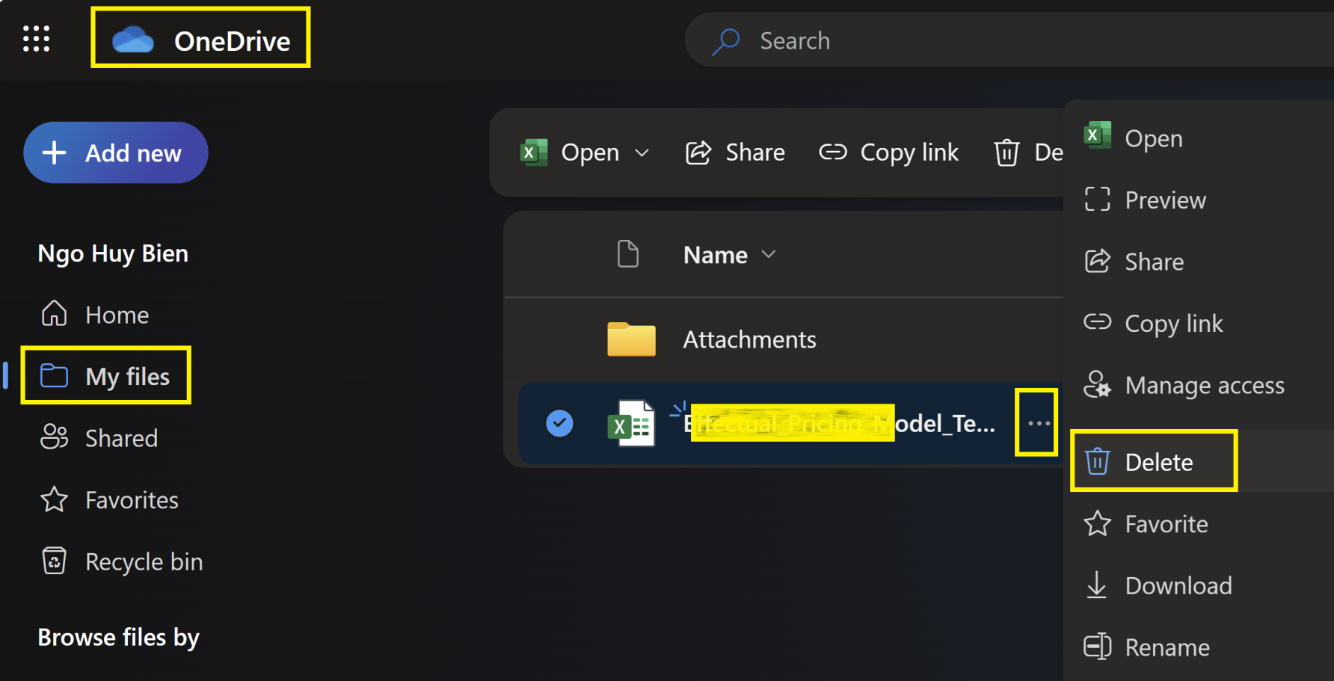
Delete O365 Excel Files
Open OneDrive web app.
Click My files link on the left menu.
Hover a file name, click three dots icon, click Delete twice.

Slide 18

Thank You & See You Again

